Slide 1
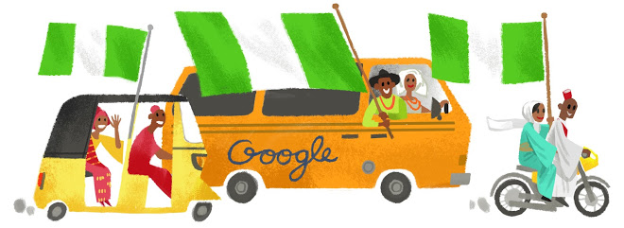
THE REAL NAIJA
No Surprises Event plan for the Nigerian cultural immersion event

Slide 2
Table of Content
Event Details
The Brief
Our Understanding of Your Needs
The Big Idea
Appendices

Slide 3




Event Details
Tuesday, 25th July
6 - 10 pm
Landmark Centre, Hall 2
200 pax

Slide 4
The Brief
Create and design an immersive experience that showcases the impact of Google and tech in the Nigerian social fabric, through celebrating Nigerian arts, theatre, culture and entertainment

Slide 5
Our Understanding of Your Needs
Event | Google Presents: The Real Naija Theme: Tales by Moonlight - stories from Nollywood, music, fashion and the arts
Location | Landmark Centre, Hall 1
Duration | 7pm – 10pm
Dress Code | Runway-ready traditional
Target Attendees | Key influencers across arts, music, fashion, Nollywood and YouTube
Key Messages | Google Cultural event intends to celebrate and promote the diversity Nigerian Culture Google is Nigerian and supports the promotion of Nigerian arts and culture Position Google as a wholly Nigerian brand
Event Strategic Goals | Create an experience for Google executives that provides an immersion into Nigerian Culture past and current Present a networking opportunity with the creative industry
Budget | $70,000 (₦22,050,000) max (still in discussion)

Slide 6
Updated - Planned agenda of activities (28/06/17)
Agenda Segments | Planned activities | Objective
Welcome | - Photo ops - Welcome drinks | Meet & greet/networking opportunities
Visual Art Exhibition | - Art and sculpture gallery - Traditional art making demonstrations (traditional fabrics, scarves, hair styles) | Exhibition of artwork by local artists
Nollywood | - Scene from a stage play - Nollywood movie highlights - 2 stories on the evolution of local film from Nollywood legends | Showcase the evolution of Nollywood, old and new through to YouTube
Fashion | - A story of Nigerian fashion - A display of Nigerian fashion old and new | Celebrate and showcase the fashion in Nigeria
Music | Musical band exploration of Nigerian music genres | Explore the evolution and propagation of Nigerian music worldwide
Notes:
Note: Policy team (Titi asking for 5 mins for the Minister of Information & Culture Lai Mohammed to speak)
Kunle - Isoken, Joke, play

Slide 7
Dress Code: Runway-Ready Traditional
To tie into the theme of the event, and influence the picturesque ambience of the event

Slide 8
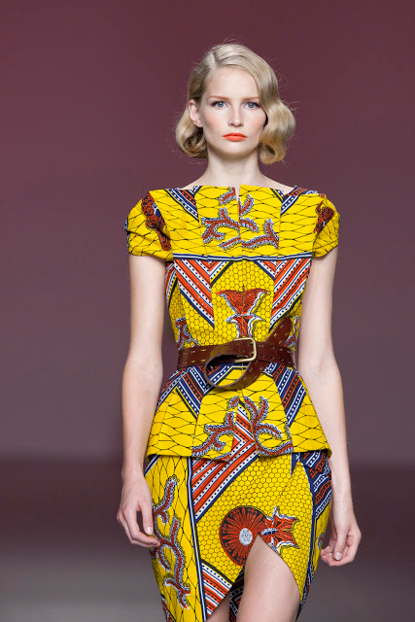
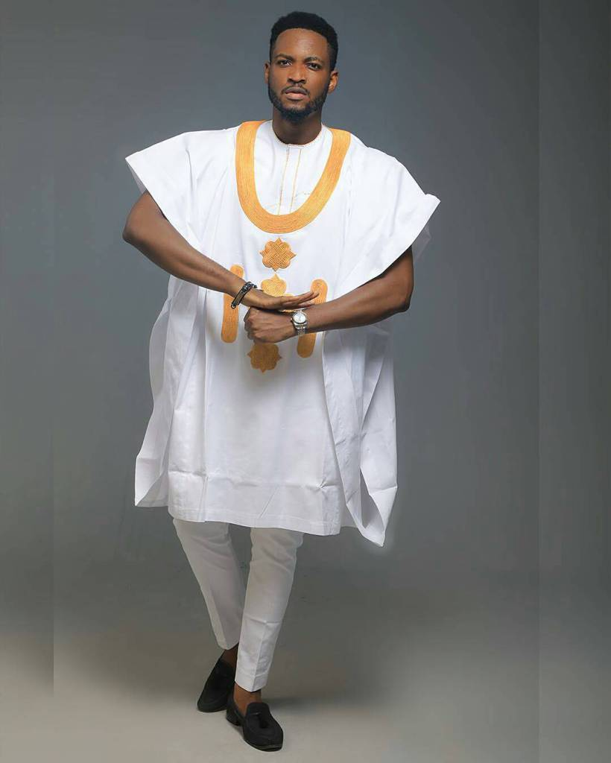
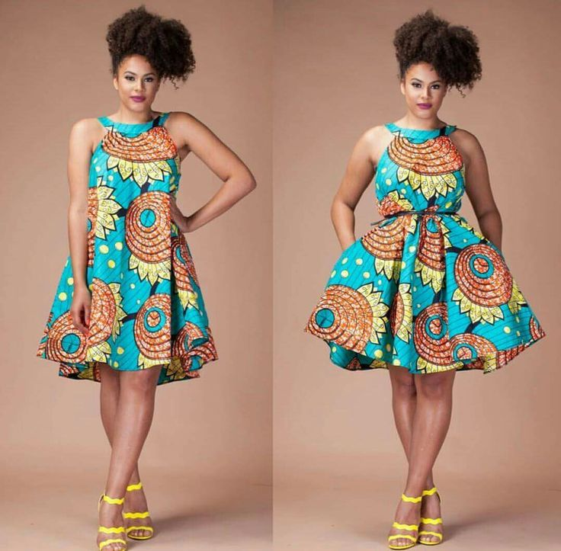
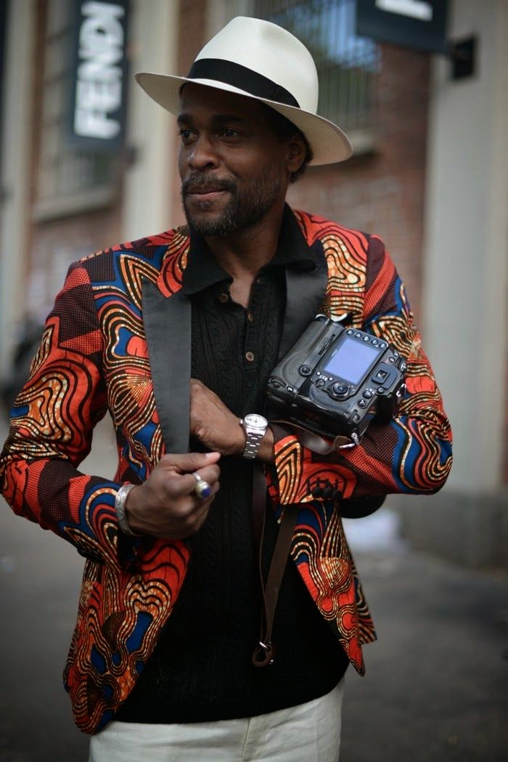
Guests will be invited to wear traditional and modern Nigerian attire to further celebrate the diversity of Nigerian fashion and personal style

Slide 9
The Big Idea

Slide 10
Overall setup
The Theme: “Tales by Moonlight” - a storytelling approach to flow through all the activities.
Overall event look and feel to be modelled after a rustic Nigerian garden
Space to be divided in three areas:
The welcome area - for the welcome area photos against the media wall
The visual art gallery & exhibitions area - where Nigerian art, photography, sculptures and paintings and fabric-making demos will be on display
The entertainment area - where announcement, theatre performance, fashion display and music performances will take place. Planned layout is a lounge setup
Primary color theme for the main event area for performances - wood, iron, greenery and white

Slide 11
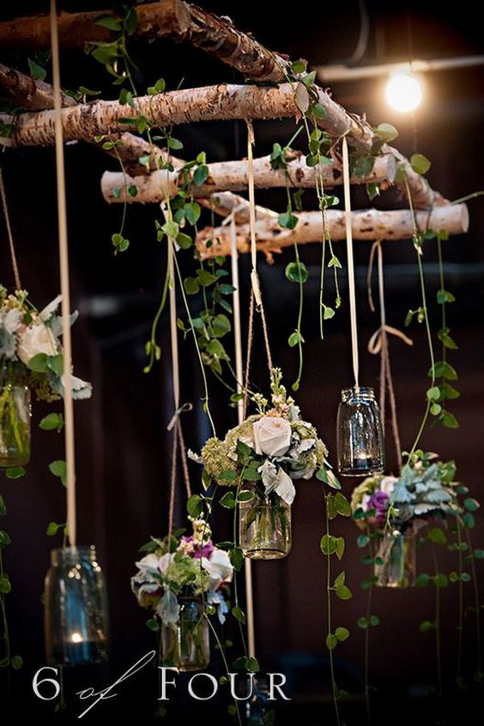
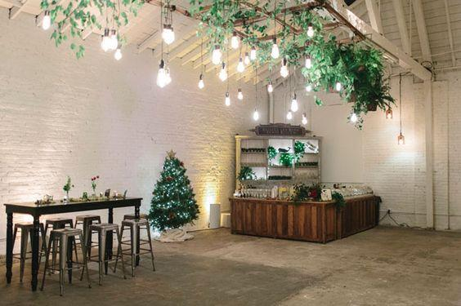
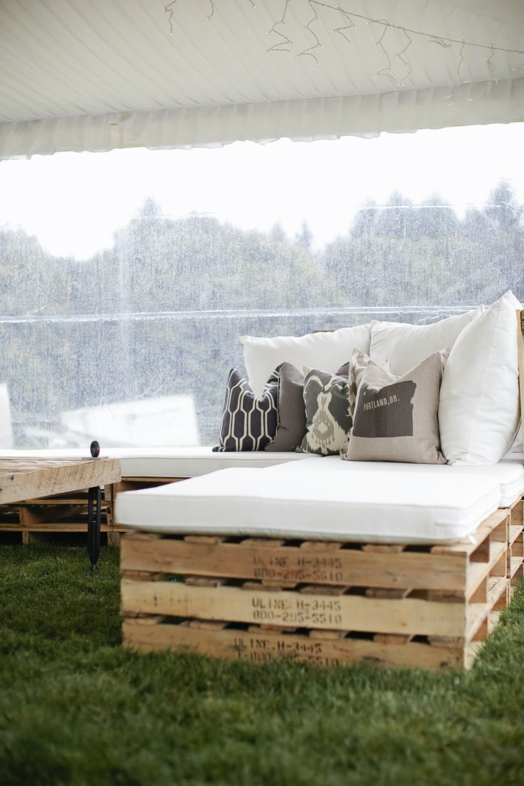
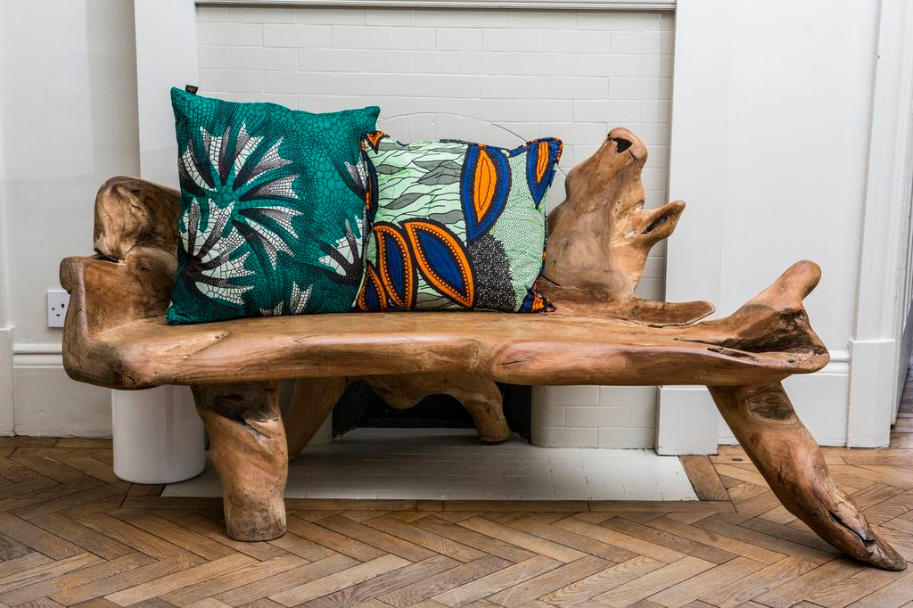
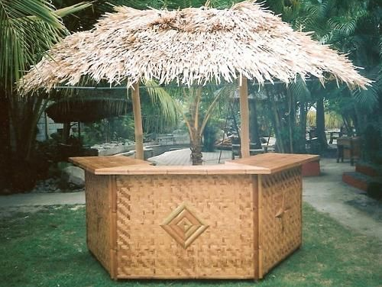
Overall event inspiration - look and feel

Slide 12
Layout and Design

Slide 13
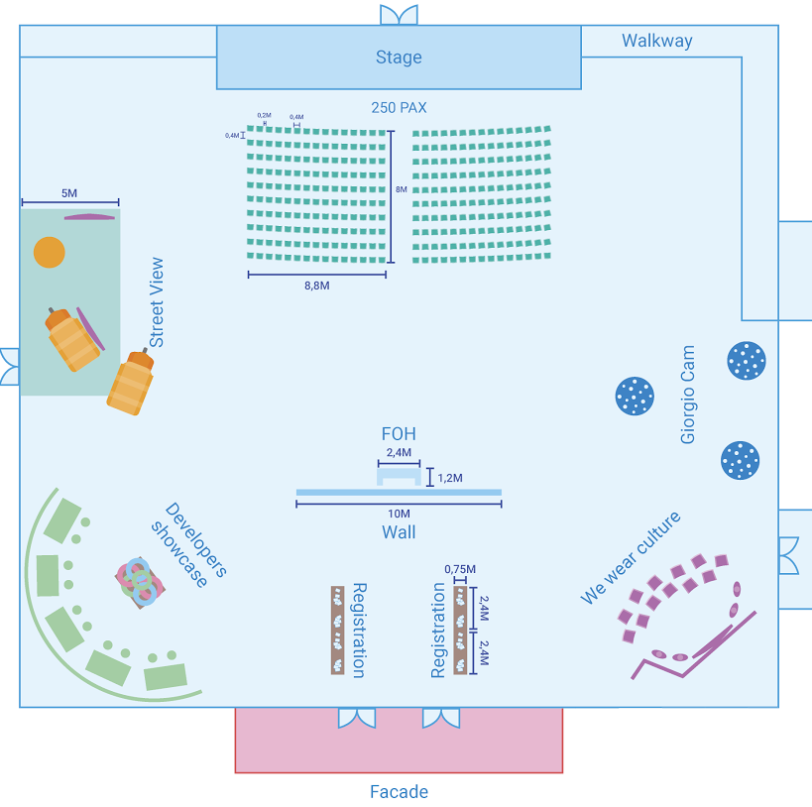
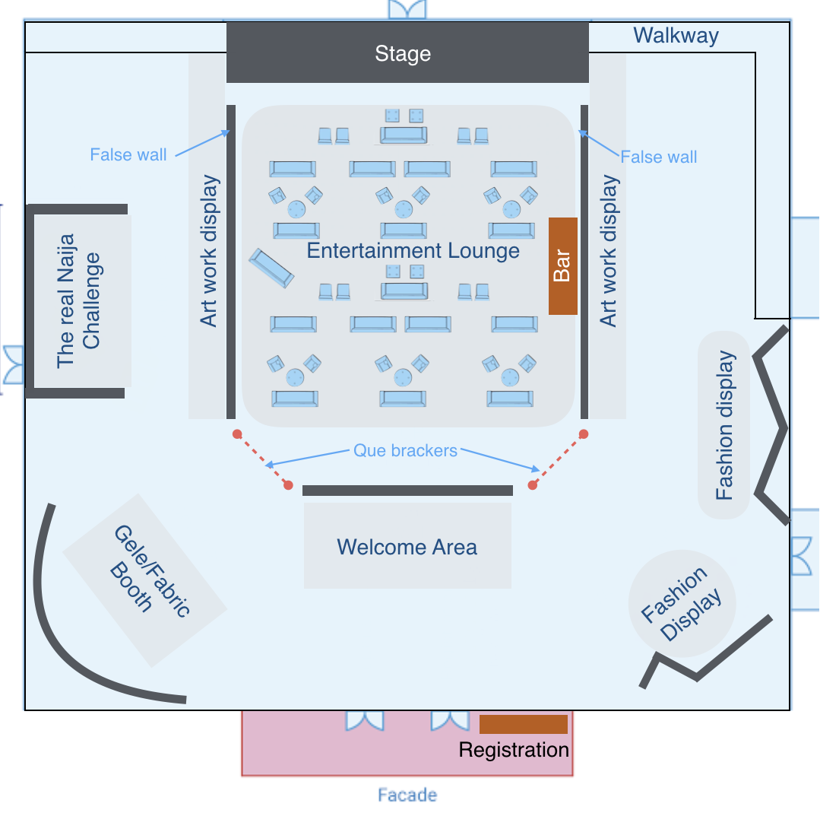
Spatial Layout

Slide 14
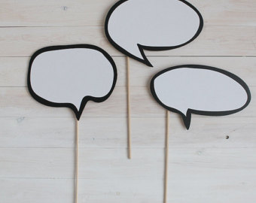
Welcome Experience
Walkway entrance will be the guests’ first engagement with the Google brand at the event.
Current design for backdrop incorporating Google brand.
Photography of guests upon arrival against the backdrop
GEMs to direct guests to the visual art area for cocktails and finger foods
Great day to be Nigerian
#WeWearCulture
I’m here for the jollof

Slide 15
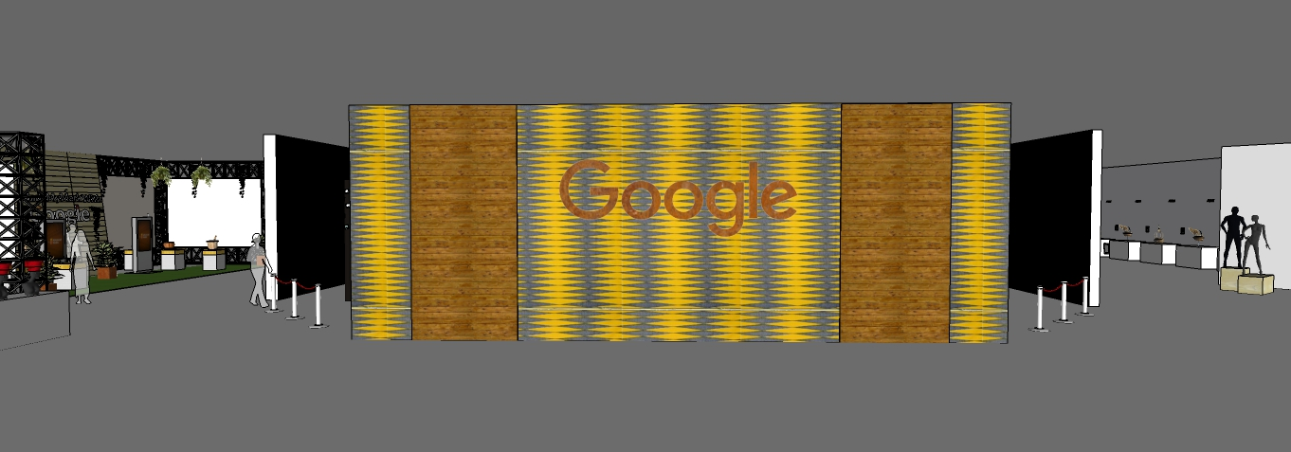
WELCOME AREA
Google logo in rust texture welded into wooden boards
Existing wall for G4N event
Wooden board on both sides of google logo

Slide 16
The Visual Art Museum - Setup
To be set up like a museum gallery.
Artwork, sculptures and photography to be on display.
Headtie display - Mannequins to be adorned with various creative styles of Nigerian head gear (aka gele - head ties - and fila - men’s caps).
Black and white framed photos of masquerades and traditional hairstyles to be displayed
Live fashion gallery with 20 models adorned in rich Nigerian traditional outfits and 10 models high fashion statement pieces from commissioned designers.

Slide 17
The Visual Art Gallery - Activities
Curator to be on standby to give brief history on the art pieces.
Live fashion models to engage and interact with guests, take photos with them and tell them a bit about what they’re wearing.
Waiters circling the gallery with trays of traditional cocktails and finger foods to be served to allow for easy interaction and networking. Refreshments to be replenished at each activity area.
Vegetarian options to be made available.

Slide 18
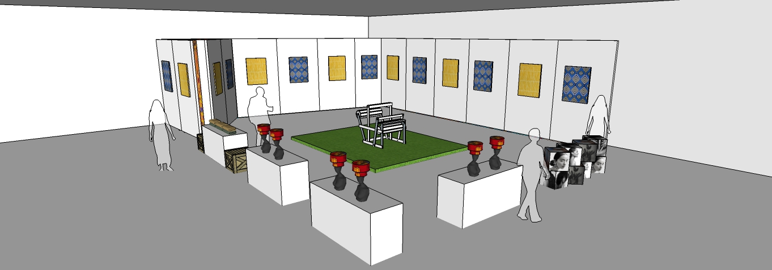
UPDATED FABRIC/GELE EXHIBITION
View 1
Moveable walls with framed fabric of different types
Live gele tying station with displayed fabric on re-used furniture
Pedestals for GFN to be re-used
For gele display
Hairstyle cubes
Gele and fila display

Slide 19
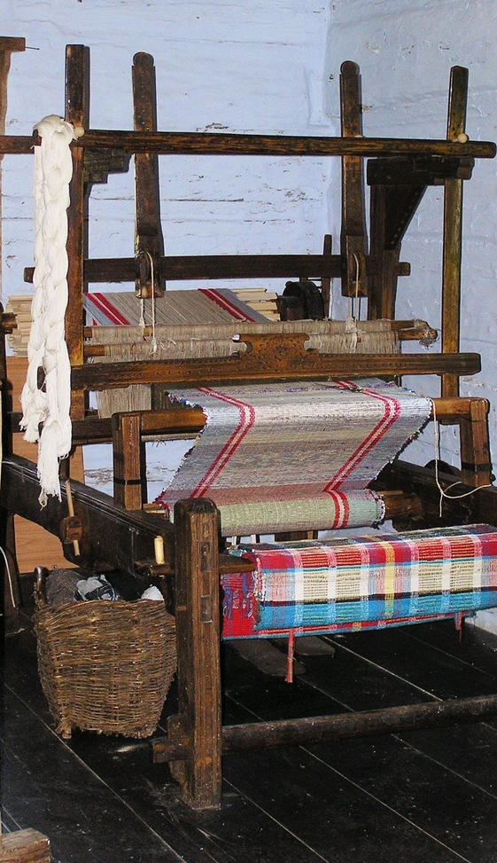
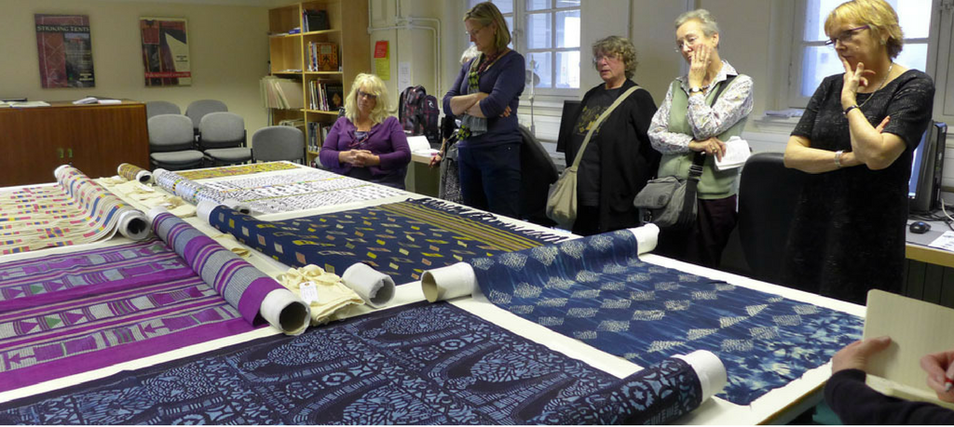
Adire and Aso Oke making demo inspiration

Slide 20
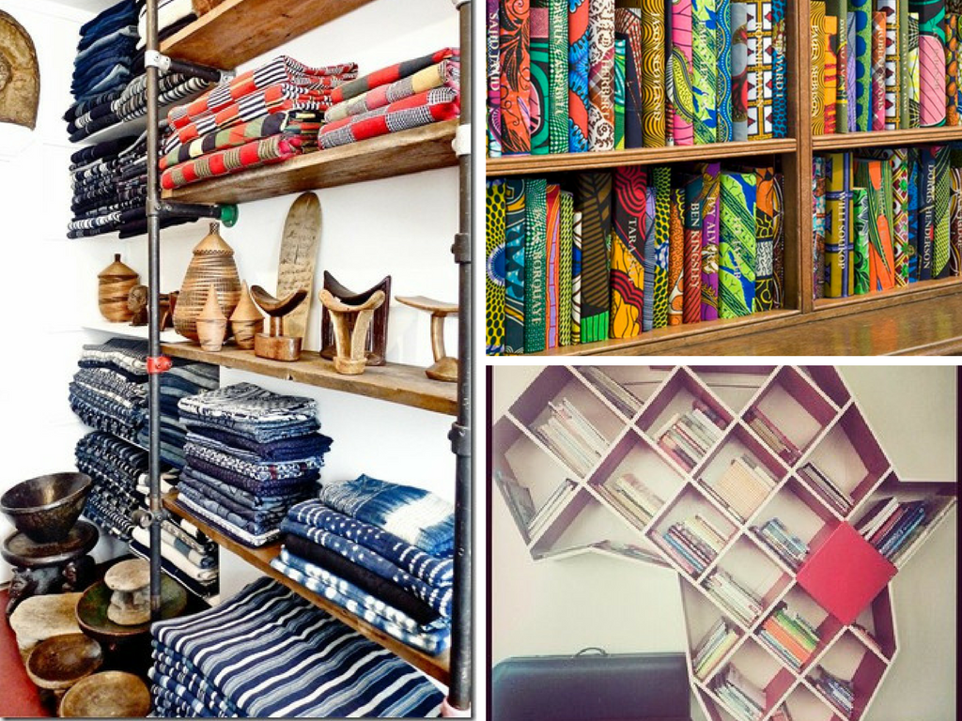
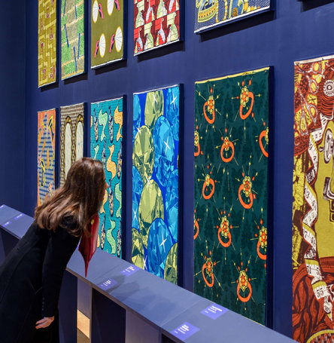
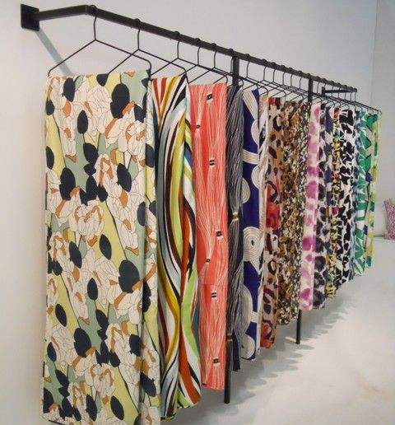
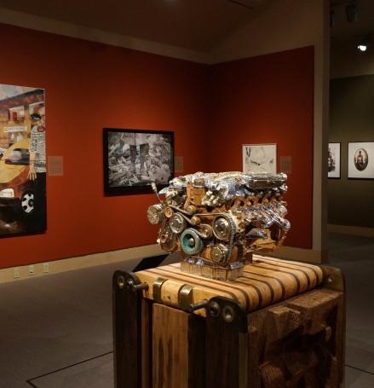
Local fabric display in fabric demo area (Ankara, adire, aso oke)

Slide 21
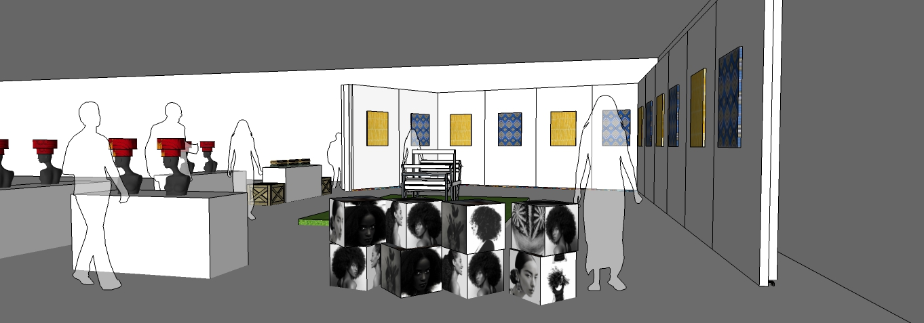
UPDATED FABRIC/GELE EXHIBITION
View 2
Photos of various hairstyles displayed on stacked wooden cubes

Slide 22
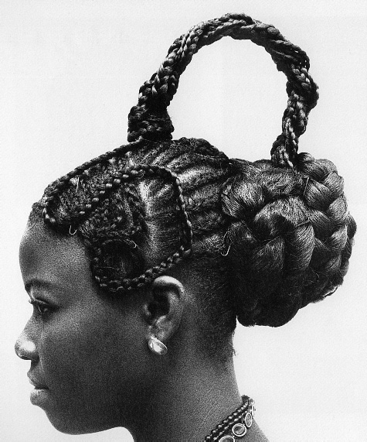
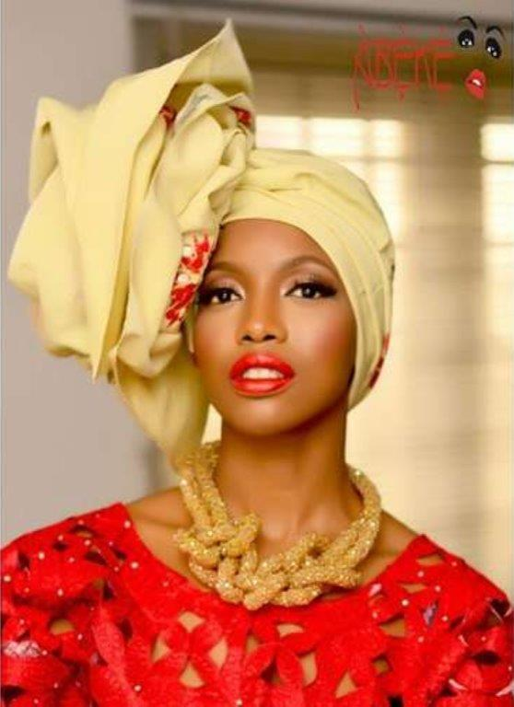
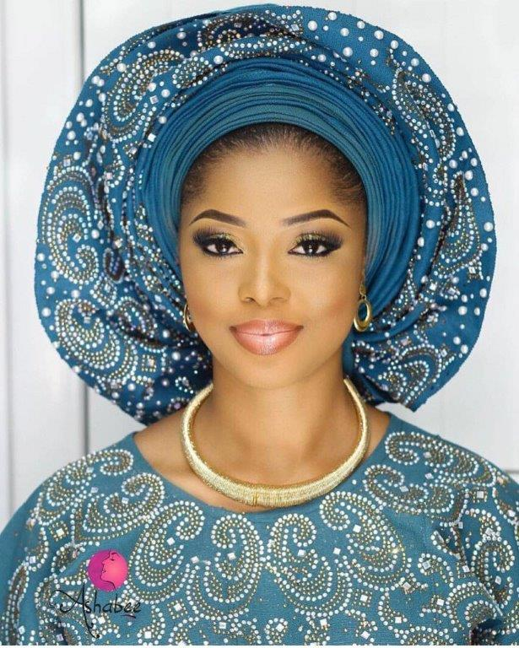
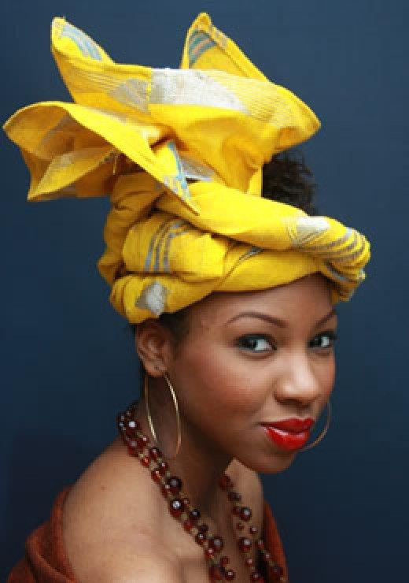
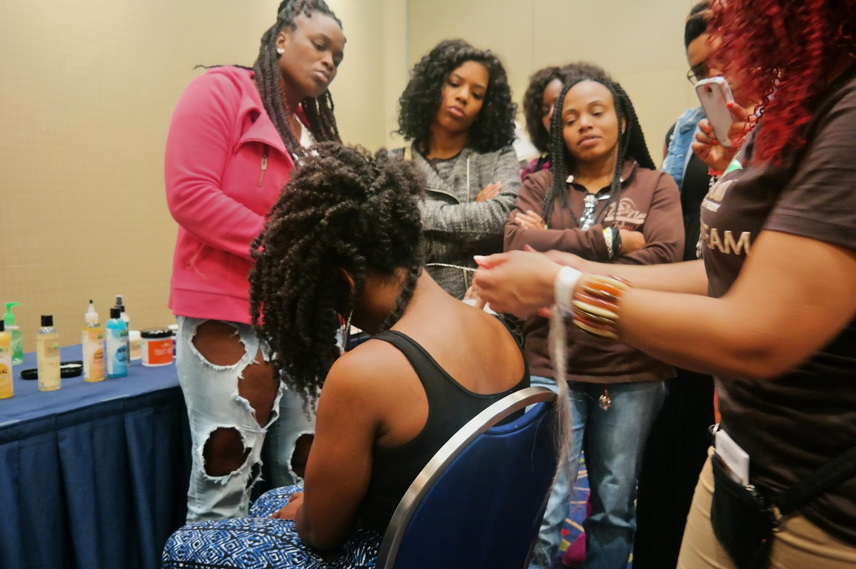
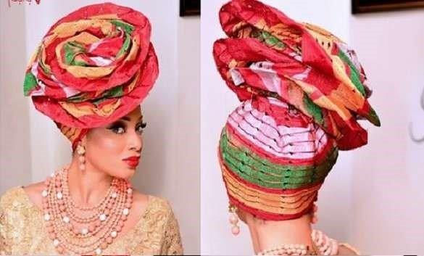
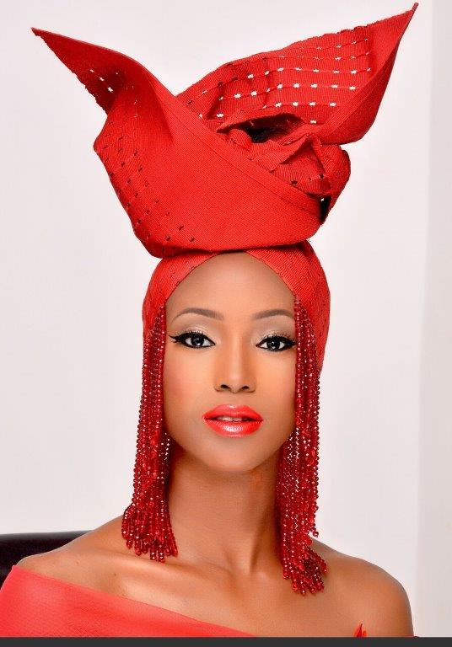
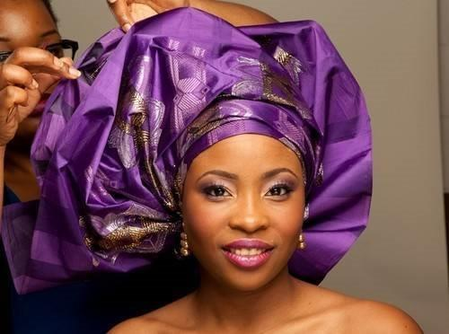
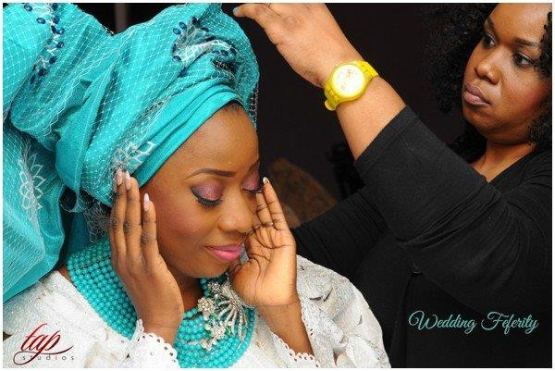
Gele tying (headtie demo)

Slide 23
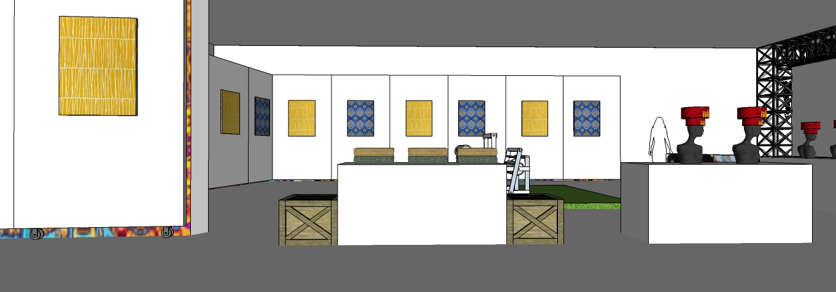
CALL OUT: GELE DEMO STATION
View 3
Wooden benches to seat visitors
Re - used furniture to be used for stacked fabric display

Slide 24
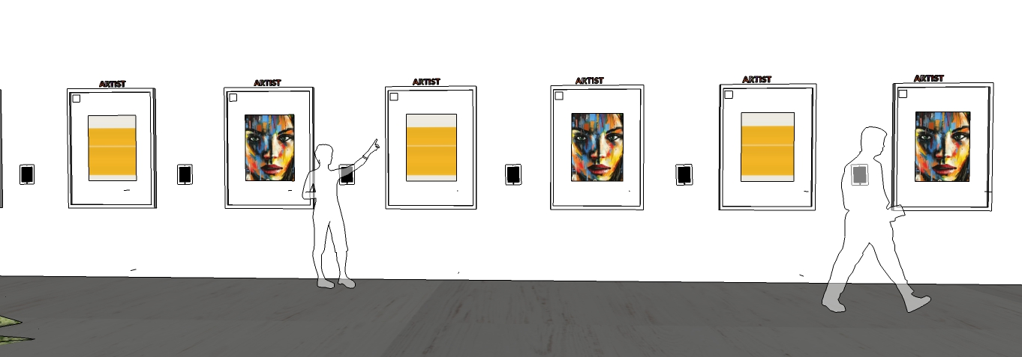
UPDATED ART WORK DISPLAY
Artist name to be displayed on false wall using self adhesive vinyl
Artwork to be hung on planned false wall

Slide 25
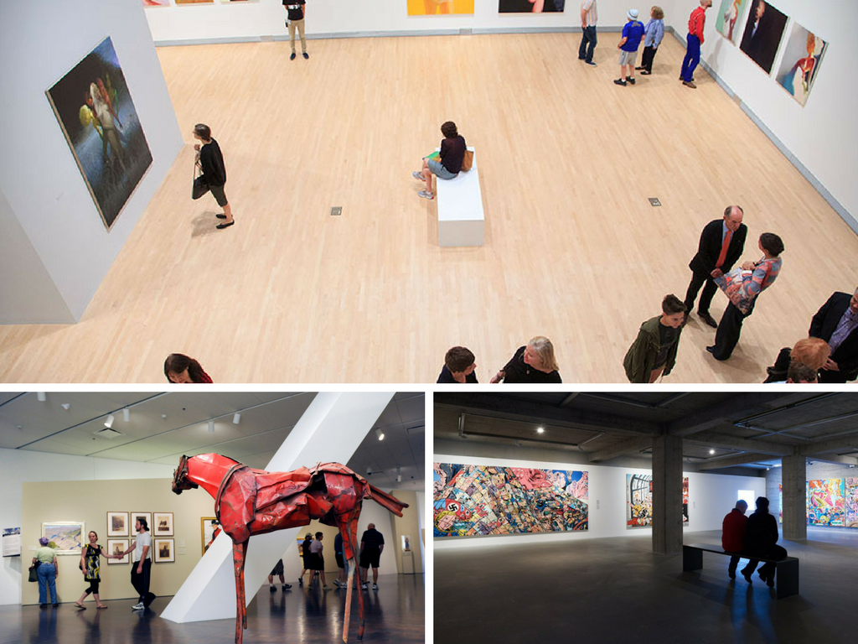
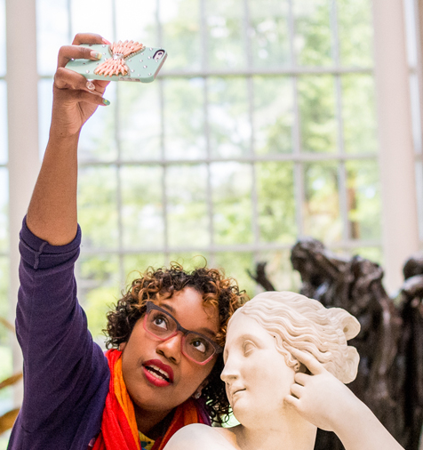
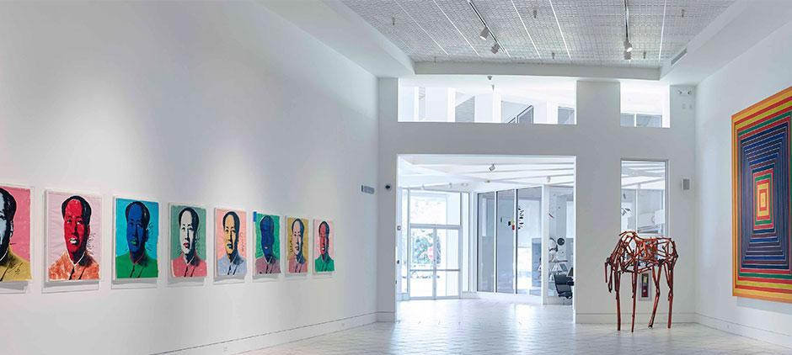
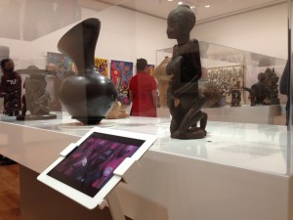
Overall gallery inspiration - Look & feel

Slide 26
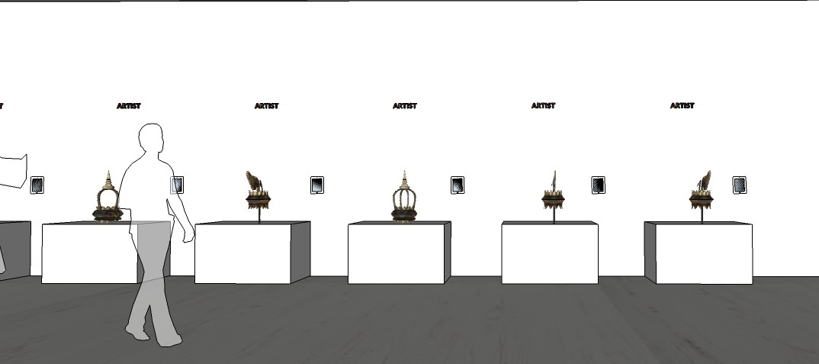
SCULPTURE DISPLAY
Sculptural display

Slide 27
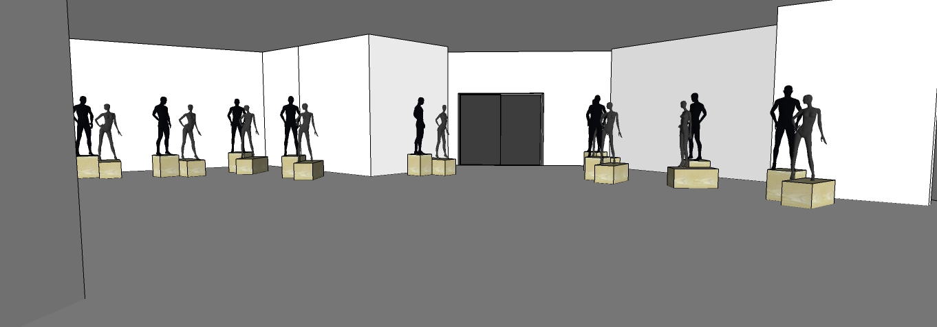
UPDATED FASHION DISPLAY
We wear culture structure to be re - used
Giorigo structure to be re - used

Slide 28
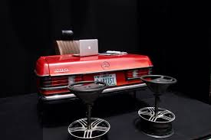
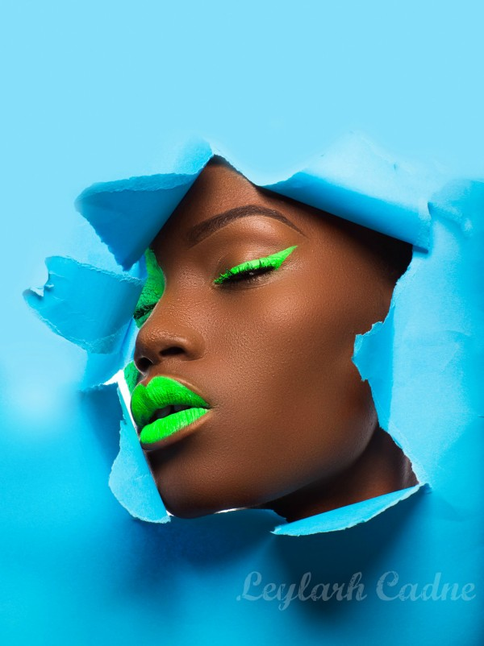
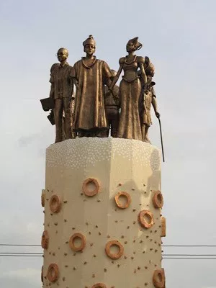
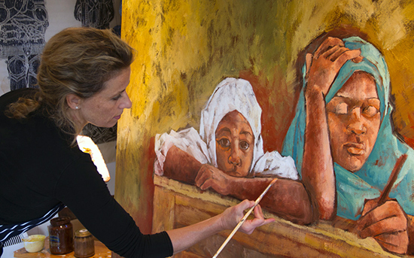
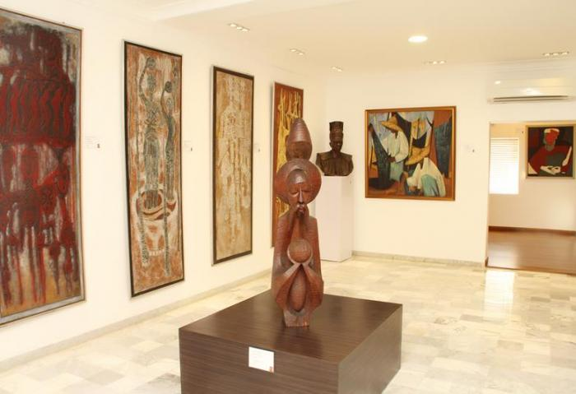
Diseye Tantua
Emmanuel Oyeleke
Gerald Chukwuma
Polly Alakija
Omenka Gallery

Slide 29
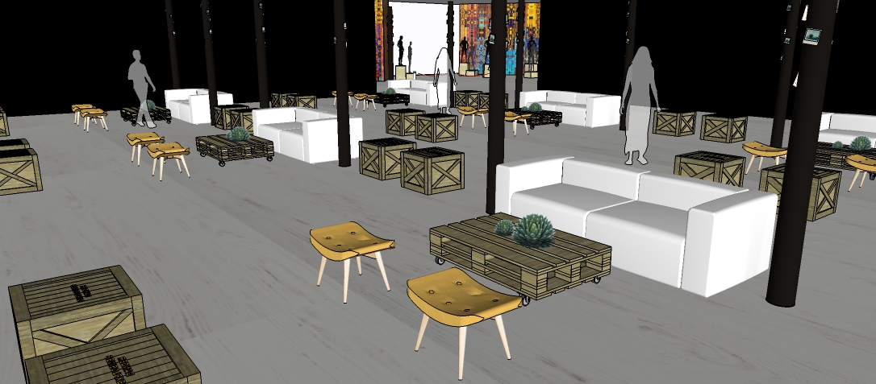
ENTERTAINMENT LOUNGE
View 1
Pallet furniture

Slide 30
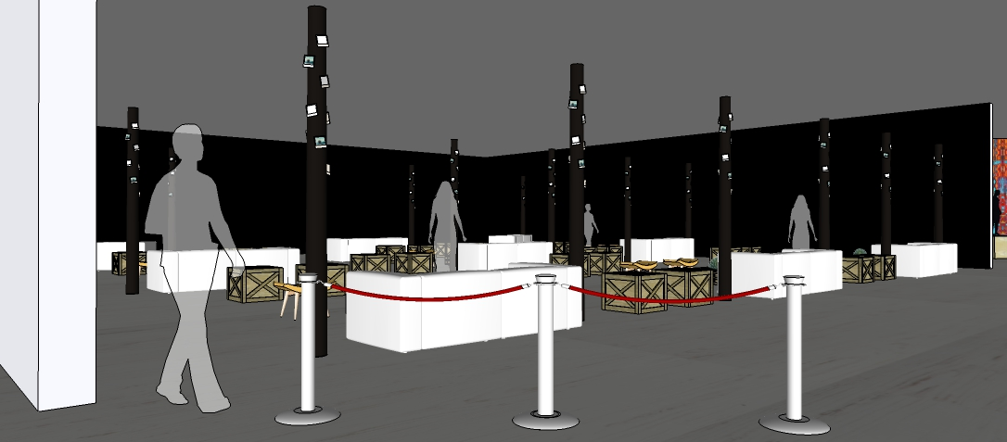
ENTERTAINMENT LOUNGE
View 2
Entry to entertainment lounge
Cue breakers

Slide 31
Nollywood - Setup
All activities to take place on the stage being set up for all entertainment activities
A video mashup displaying the evolution of the old and the new to display on the two large LED screens
Silent footage of a variety of Nigerian movies during storytellers performance (Nollywood on stage and Nollywood on film)

Slide 32
Nollywood - Activities
In a Tales by Moonlight forma, theatrical storytellers to sit on a wooden chair as they tell their stories, with a spotlight focused on them only
Lightning talk to be lightly scripted and tells the story of the evolution of Nollywood
Furniture to posses ankara themed throw pillows, woodwork and ottomans
A short scene from a local popular stage play for strong cultural engagement
Public viewing of a recently released new Nollywood movie - Snippets from “Isoken” to be played on screen

Slide 33
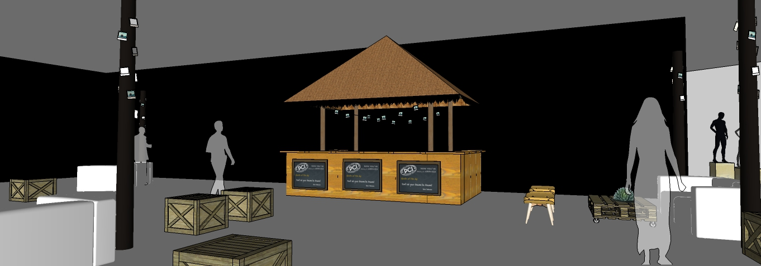
UPDATED BAR
Thatch hut
Bamboo
Pallet counter

Slide 34

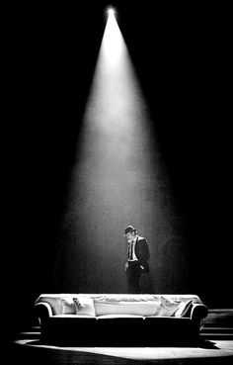
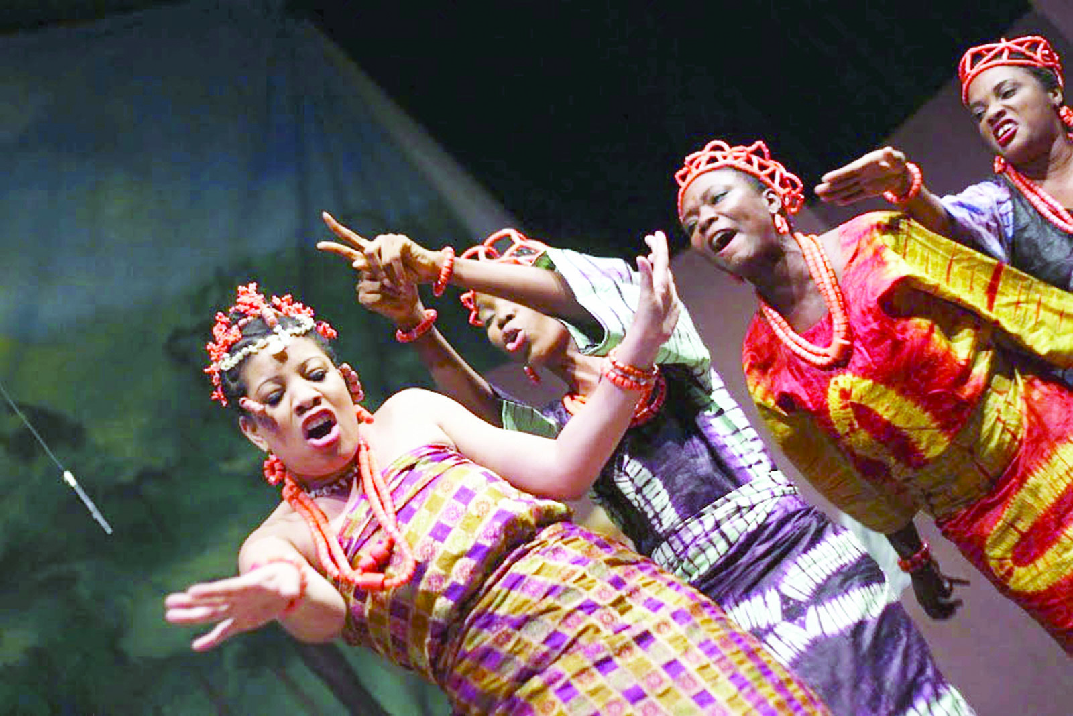
Stage plays, movie snippet and storyteller scenery

Slide 35
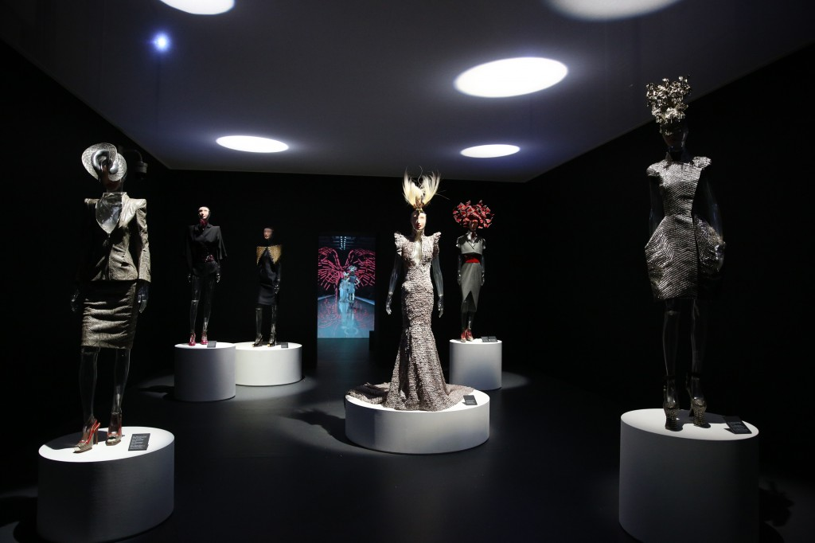




Fashion - Activities (at the entertainment area)
Stories of Nigerian fashion (#WeWearCulture)
During the storytelling models of traditional attire will file out dramatically and get into formation on the main stage traditional and modern fashion

Slide 36
Music Performances - Setup and Activities
Section to kick off with a YouTube video of Joromi by Victor Uwaifo.
First act (the band) to be introduced on stage with lighting, as they join into the last part of the song in the video
Band to do a medley of the generational music and transition into the new school era of music, as they tell a story about the history of some of the songs.

Slide 37


An MC and live band will bring the event together
Live Band - Veentage
Live Band - Shuga Band
MC - Chigurl

Slide 38

The Real Naija Challenge - Setup and Activities
A fun interactive challenge - especially for non-Nigerian visitors
To consist different activity sections where guests complete small tasks to become/prove they are a true Nigerian
8 Things You Must Do To Be A Certified Nigerian
Taste palm wine
Eat small chops.
Eat jollof rice.
Tie a gele or wear a fila
Learn to do a Naija dance step.
Say something in pidgin or learn a greeting in a Nigerian language
Take a picture with a mortar and pestle
Beat a talking drum

Slide 39

FRONT VIEW: REAL NAIJA CHALLENGE DEMO AREA
Pre existing imagery to be re - used
Wooden platforms displaying various props for new naija challenge
Pre existing backdrop
Pre existing structure to be used for hanging plants

Slide 40



Guest Experience Managers
To be adorned in specially designed print of ankara skirt for the event and white shirt, and to wear native hairstyles from different tribes (e.g. Kiko, fulani hairstyles)

Slide 41
Catering and Beverages
Traditional Naija food and drinks to be served, to give the newbies a taste of the real Naija food experience, and to trigger nostalgia for the Nigerian attendees.

Slide 42









Small chops menu inspiration

Slide 43






Local drinks and cocktail inspiration

Slide 44




Small chops display inspiration

Slide 45
Appendix 1: Selected outfits for cultural live fashion gallery

Slide 46






Yoruba
Ibo
Fulani (female)
Fulani (male)
Ijaw
Efik

Slide 47







Itshekiri
Kanuri (female)
Esan
Tiv
Kanuri (male)
Edo

Slide 48
Appendix 2: Event Communication and Guest Management

Slide 49
Event Communications Plan
Item | Medium | Content | Time to be sent
Save The Date | Email | Date, time and save the date | T - 6 weeks
Digital Invitation | Google Event App | Venue, date, time and RSVP | T - 4 weeks
Confirmatory Call | Phone | To confirm if invitation has been received (for non RSVP) | T - 3 weeks
SMS | Phone | Thank you for confirming your attendance, see you there | T - 2 weeks
SMS | Phone | 1 week to go, building anticipation, event hashtag | T - 1 week
Courtesy Call | Phone | Reminder, check to be sure no plans have changed | T - 3 days
SMS | Phone | Checklist (outfit, open mind, etc), see you soon. event hashtag | D-Day

Slide 50
Mode of Invitation
Google events app to be used to send invitations to the guests.
Invitations to be non-transferrable.
SMS reminders to follow invitation leading up to the event day.
Notes:
See you there to be said in different languages.

Slide 51
Guest Management - Pre Event
Save The Date is sent to guest
Official invitation is sent to guest
Guest RSVPs. Phone call is placed through to to guest to confirm attendance if no response is received
Thank you/confirmation email is sent to guest
SMS campaign begins

Slide 52
Guest Management - Check-in
Guest arrives at venue gate
Security confirms event guest is to attend
Security hands parking tag to guests attending TRN and redirects other guests
GEM at check-in requests digital invitation. Invitation available?
Send guest to help desk – personnel pacifies guest and confirms name on guestlist. Name on guest list?
No
Personnel pulls in designated Google/PR staff to identify guest. Guest identifiable?
No
Guest is escorted from the venue
Guest is ushered into welcome area to begin their experience and enjoy

Slide 53
Teardown Plan
Teardown schedule to begin from 10pm - 4am
9:45pm - Artwork and fabric demos are taken out of the entertainment area.
10:00pm - Food service ends.
10:15pm - Drink service ends.
10:30pm - Music stops, teardown begins.
20 additional staff to assist in a swift pull down of setup.
Reusable costumes and equipment to be left on site for Thursdays event.

Slide 54
Thank You

